Slide 1

Pujari Atlanta
welcomes you
to
Durga Puja 2009
Sharada Shubbeccha

Slide 2
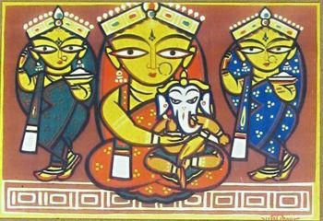
‘Mrinmoyee’ – the essence of Bengal…
Pujari's theme for 2009 ‘Durgotsav’
‘Mrinmoyee’ essentially means 'of the earth' and Pujari has tried to capture this mortal image of the goddess through art, pottery and cultural extravagance.
The traditional folk art…
‘Potchitro’ or story telling through depicting images on pottery and canvas has always been a traditional form of art and entertainment in India. The trail goes a long way back to the Middle Ages when story telling was an important form of entertainment in Bengal.
This year, Pujari’s decoration team in their quest to capture simplicity embodied in the life of the folk people, has imbibed this tribal art form in their theme and has tried to tell the story of festivity and celebrations embracing the most important festival of every Bengali’s life; namely ‘Durga Puja’, through their bold rustic strokes, vibrant colors, eloquent figures and colorful motifs…
Inspired by the works of the famous painter of Bengal – Jamini Roy (Padma Bhushan), the decoration team attempts to lend a tangible feel to their concept of worshiping the goddess in Mrinmoyee form, that weaves us into the very fabric of rural Bengal.

Slide 3


Thanks to our Gold Sponsors

Slide 4
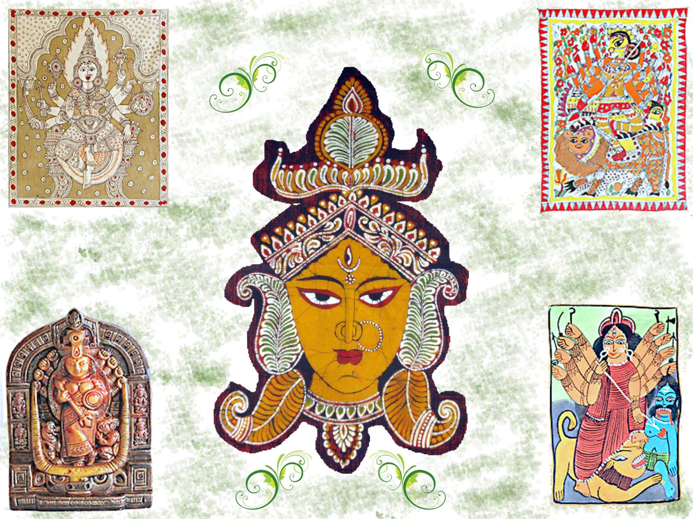

Slide 5












Thanks to all our Sponsors

Slide 6
Thanks to all our Sponsors

Slide 7
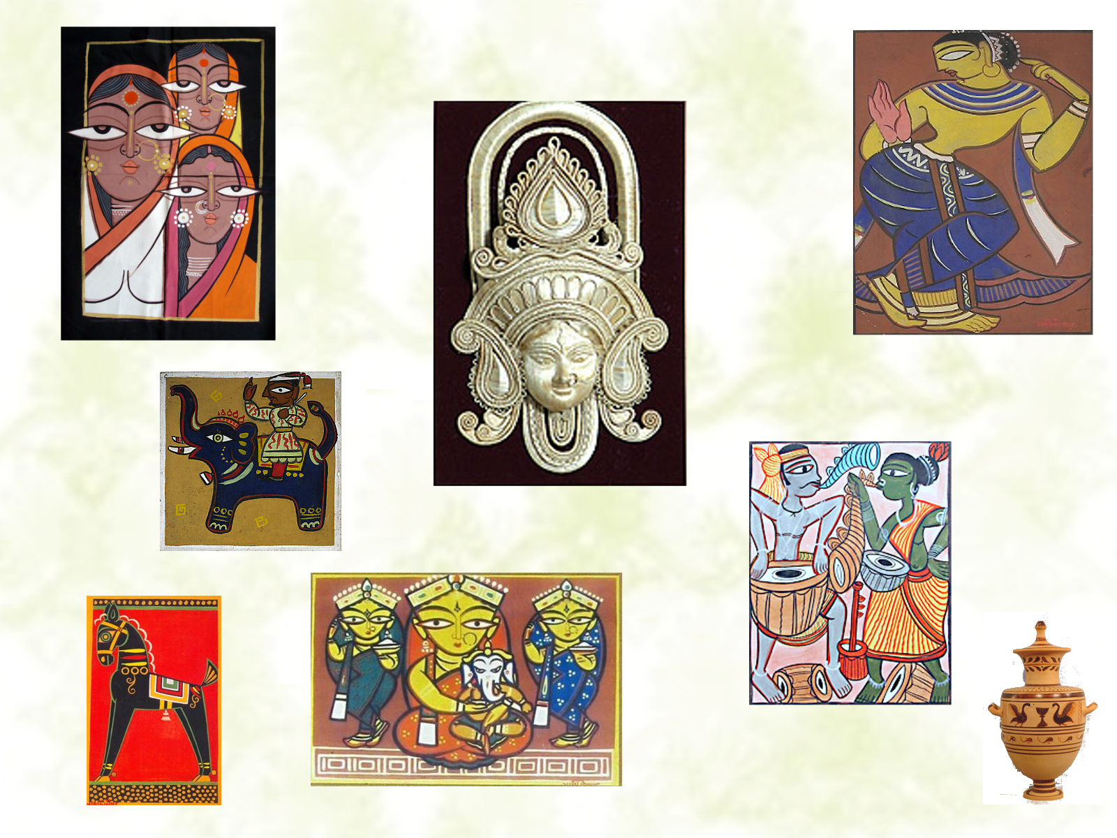

Slide 8
Thanks to all our Sponsors

Slide 9
Thanks to our Gold Sponsors

Slide 10
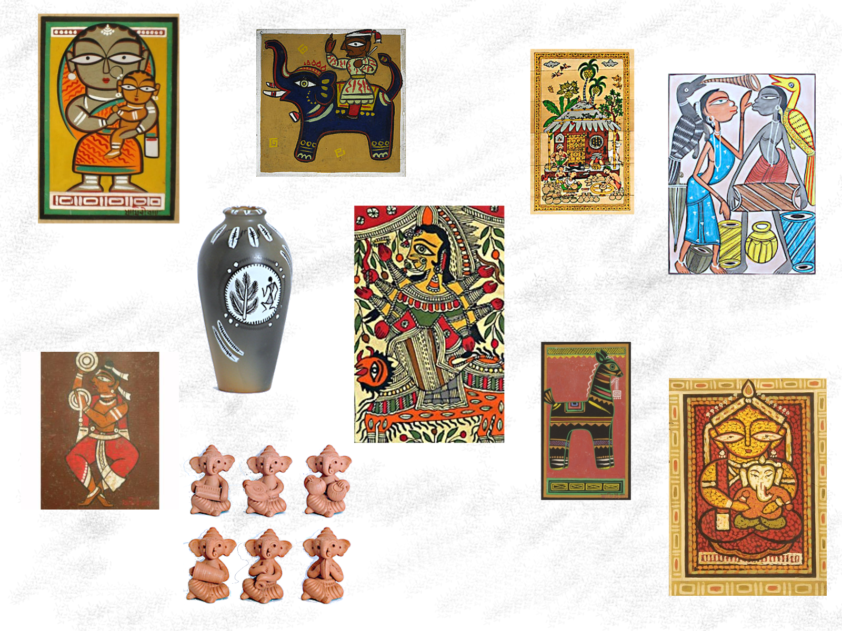

Slide 11
Thanks to all our Sponsors

Slide 12
Thanks to all our Sponsors

Slide 14
Thanks to all our Sponsors

Slide 15
Thanks to our Gold Sponsors

Slide 17
Thanks to all our Sponsors

Slide 18
Thanks to all our Sponsors

Slide 20
Thanks to all our Sponsors

Slide 21
Thanks to our Gold Sponsors

Slide 23
Thanks to all our Sponsors

Slide 24
Thanks to all our Sponsors

Slide 26
Thanks to all our Sponsors

Slide 27
Thanks to our Gold Sponsors

Slide 29
‘Mrinmoyee’ – the essence of Bengal…
Pujari's theme for 2009 ‘Durgotsav’
‘Mrinmoyee’ essentially means 'of the earth' and Pujari has tried to capture this mortal image of the goddess through art, pottery and cultural extravagance.
The traditional folk art…
‘Potchitro’ or story telling through depicting images on pottery and canvas has always been a traditional form of art and entertainment in India. The trail goes a long way back to the Middle Ages when story telling was an important form of entertainment in Bengal.
This year, Pujari’s decoration team in their quest to capture simplicity embodied in the life of the folk people, has imbibed this tribal art form in their theme and has tried to tell the story of festivity and celebrations embracing the most important festival of every Bengali’s life; namely ‘Durga Puja’, through their bold rustic strokes, vibrant colors, eloquent figures and colorful motifs…
Inspired by the works of the famous painter of Bengal – Jamini Roy (Padma Bhushan), the decoration team attempts to lend a tangible feel to their concept of worshiping the goddess in Mrinmoyee form, that weaves us into the very fabric of rural Bengal.

Slide 30

As an extension to our ‘Mrinmoyee’ theme,
Pujari is hosting a Pottery Workshop
on Saturday, 26th Sept. 2009 at 11:00 am.
The event is a free event for youth which will focus on the awareness of a nearly extinct tradition of India through a hands-on workshop. Inhabitants of the Indian subcontinent have known the art of modeling and painting since prehistoric times. It is evident that pottery culture, mural or painting is a very old tradition in India. The country has a rich tradition of clay crafts and pottery throughout the country. There is hardly any festival or ritual, which is complete without the use of earthen lamps, the earliest example of pottery culture. The young generation will learn the rich art and culture that was once predominant in Indian subcontinent, the influence of this art in their daily life and how did it help them to develop the ancient civilization.
They will experience the uniqueness of this industry by actively participating in the workshop. They will get exposure to the importance of an industry which is eco-friendly, absolutely pollution free and provides ample opportunity to grow in the long term with a sustainable plan to make it economically competitive. The workshop will be conducted by experienced teacher Tumpa Bhattacharyya, a graduate from Kala Bhavana Santiniketan in the field of Ceramic/Pottery and by Sutapa Datta, a leading entrepreneur in the areas of graphic designing and digital art. Materials and other equipment will be supplied by Pujari and there is no cost involved to the participants.

Slide 31

Georgia Association
of Physicians of Indian Heritage
Foundation
Applications are invited for GAPI EDUCATIONAL AWARDS for 2009-2010 for students in undergraduate or graduate programs.
Awards are given based on applications received from students of Indian origin resident in the State of Georgia.
A total of six awards for $1000 each are available. Of these, three awards will be merit based and three awards will be need based.
Candidates who do not provide financial support information will be considered for the merit based awards only.
The last date for receipt for completed applications is Monday, February 1, 2010. Awardees will be notified by e-mail latest by Monday, March 1, 2010. It is mandatory for awardees to be present at the GAPI Annual Meeting in Atlanta on April 10, 2010 to receive the award. The exact venue for the meeting will be announced on the GAPI web site at a later date. Failure to be present at the meeting will either result in the award being cancelled or given to the next deserving candidate who is able to be present at the meeting.
Dr. Santanu Das Dr. P. B. Rao
President Chairman, Awards Committee
Dr. Sreeni Gangasani, President Elect
Dr. Dilip Patel, Secretary
Dr. Abhishek Gaur, Treasurer
FOR MORE INFORMATION VISIT
WWW.GAPI.ORG

Slide 32





Pujari’s online presence
In today’s online culture, viral propaganda via social web applications like blogs, twitter and facebook has become very common. Pujari has stepped up it’s online presence as well, acknowledging the need to be at par with the current wave. We would like to ask each and every one of you, to participate in this very exciting and interactive engagement. Write to us at pujariatl@gmail.com
Visit http://www.pujari.org
Get the latest updates, news and more.
Keep in touch
Indulge in the fun filled activities
Celebrate at the festivities
Participate in the cultural programs
Share your writings
Lend us your help
Taste the Bengali food
Dance to the beats of the ‘dhaak’
Follow us @ www.twitter.com/pujariatl
Retweet our messages. @ and DM us.
Join Pujari Atlanta. Invite your friends to join, and be part of the community.
Subscribe to Pujari’s Online Newsletter.
http://pujariatl.wordpress.com
Subscribe to Pujari’s Videostream.
http://www.youtube.com/user/pujariinc
Enjoy Pujari’s Photostream.
http://www.flickr.com/photos/pujariinc

